Slide 1
Introduction to Microsoft Power Platform

Slide 2
Agenda
What is Microsoft Power Platform
Data Connectors
Pulling it all together
Get started with Power Apps
Power Apps related technologies
Summary

Slide 3
Lesson 1: What is Microsoft Power Platform

Slide 4



Microsoft Power Platform
The low-code platform that spans Office 365, Azure, Dynamics 365, and standalone applications
Innovation anywhere. Unlocks value everywhere
Power BI
Business analytics
Power Apps
Application development
Power Automate
Process automation
Power Virtual Agents
Intelligent chatbots
Portals
Data connectors
AI Builder
Microsoft Dataverse
Notes:
Elaborate that next slides explains each components
AI Builder lets users and developers add AI capabilities to the workflows and PowerApps they create and use. AI Builder is a turnkey solution that allows you to easily add intelligence to your workflows and apps and predict outcomes to help improve business performance without writing code.

Slide 5
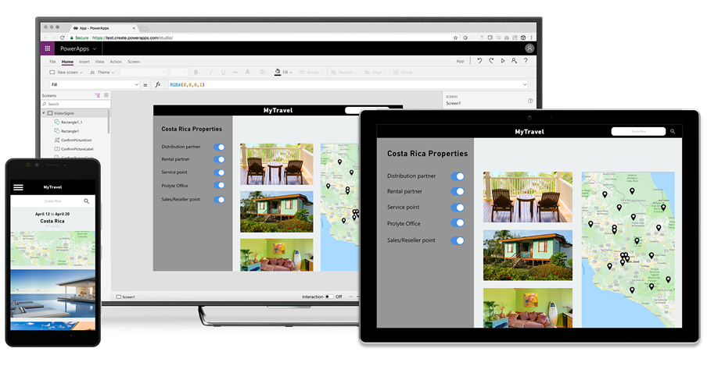
Build and consume solutions for web and mobile with Power Apps
Build highly customized task- and role-based canvas apps with data from one or multiple sources
Generate immersive model-driven apps, starting from your data model and business processes
Consume fully accessible apps across web and mobile, embedded or standalone, on any device
Notes:
Power Apps provides a rapid low code development environment for building custom apps for business needs. It has services, connectors, and a scalable data service and app platform (Microsoft Dataverse) to allow simple integration and interaction with existing data. Power Apps enables the creation of web and mobile applications that run on all devices.
People use apps for every area of their lives, and business should be no exception. Most out of the box solutions do not meet exact business needs or integrate well with other business programs. Power Apps eases users into app development with a simple interface so that every business user or pro developer can build custom apps.

Slide 6
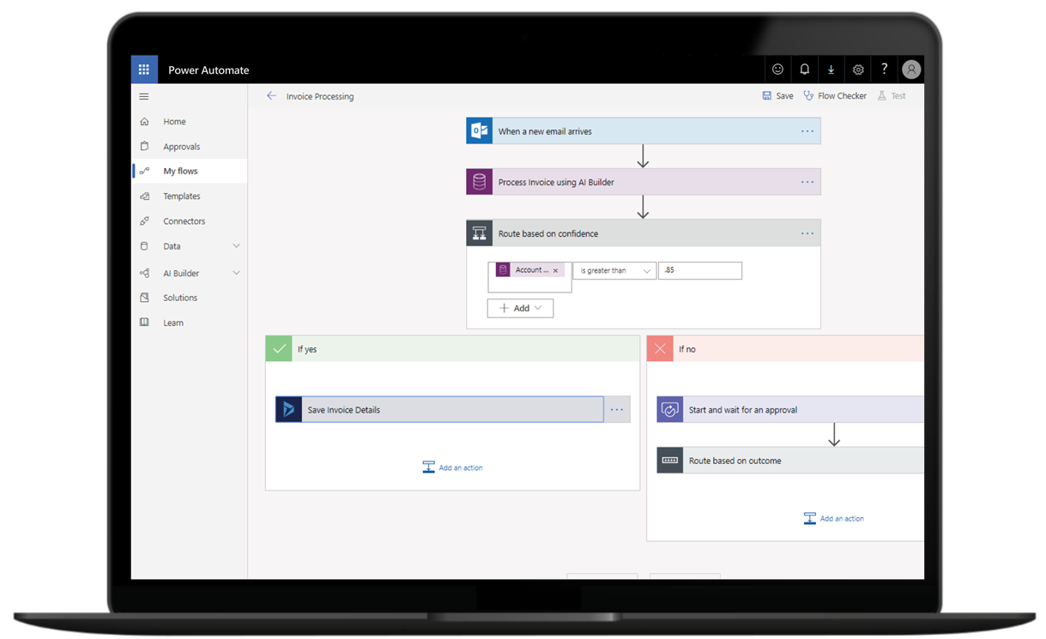
Automate and integrate business processes with Power Automate
Automate and model business processes across your apps and services
From simple automations to advanced scenarios with branches, loops, and more
Trigger actions, grant approvals, and get notifications right where you work
Automate legacy, on-prem and cloud-based applications and services
Notes:
Power Automate lets users create automated workflows between applications and services. It helps automate repetitive business processes such as communication, data collections, and decision approvals.
Don't waste important productive hours on drafting the same email for a weekly update or walking approvals through. Not only for the individual user, Power Automate allows for the creation of enterprise-grade process automation. Power Automate's simple interface allows every level of user to automate work tasks from beginners to seasoned developers.

Slide 7
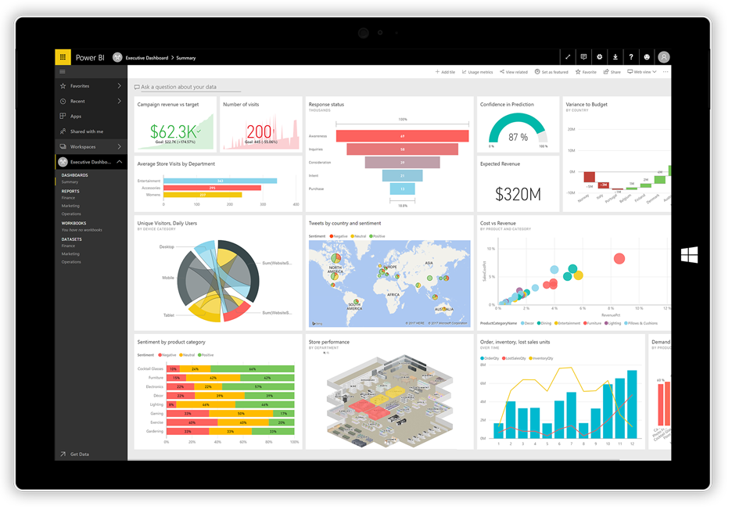
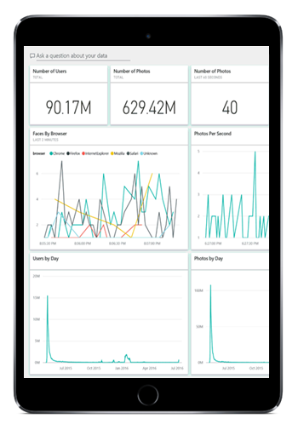
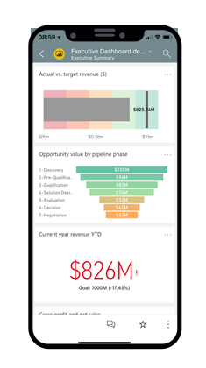
Gain insights from your data regardless of where it lives with Power BI
Connect to all your data and get a consolidated view across your business through a single pane of glass
Create ad-hoc analysis, live dashboards and interactive reports that are easy to consume on the web and across mobile devices
Build smart apps by infusing insights from your data and drive action with the power of the Power Platform
Notes:
Power BI (Business Intelligence) is a business analytics service that delivers insights for analyzing data. It can share those insights through data visualizations which make up reports and dashboards to enable fast, informed decisions. Power BI scales across an organization, and it has built-in governance and security allowing businesses to focus on using data more than managing it.
You can consider Power BI as the analysis and insights leg of the Power Platform. It takes business data and allows you to display it in ways that makes the most sense to users. A Power BI dashboard could potentially replace a standing meeting to report out on company metrics such as sales data, progress against goals, or employee performance.

Slide 8

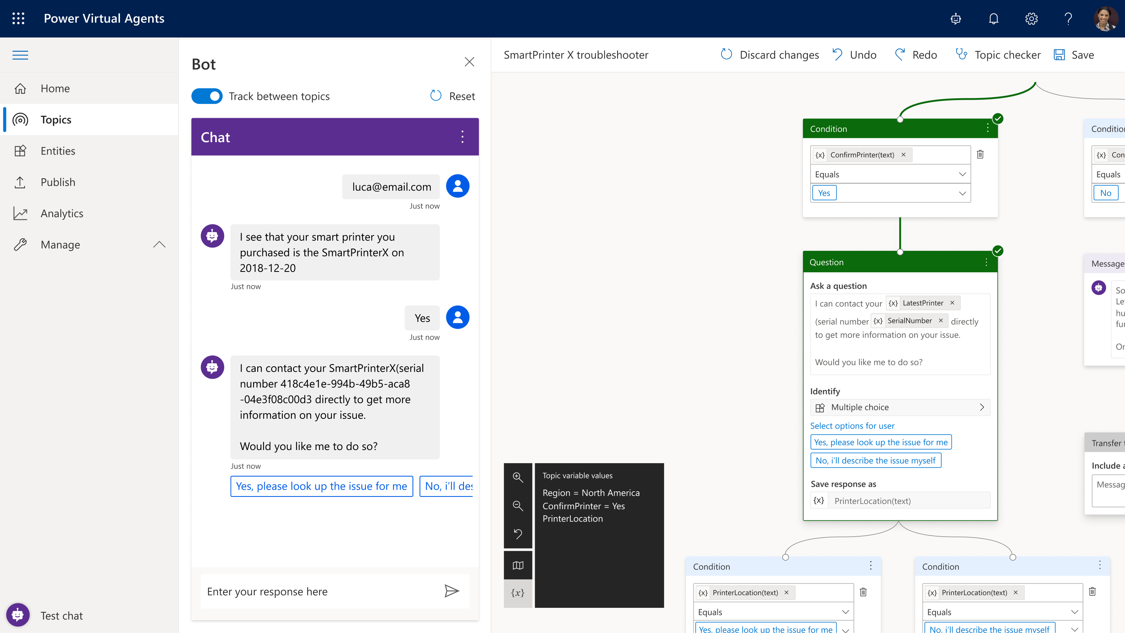
Build powerful virtual agents with Power Virtual Agents
Enable subject matter experts to easily create powerful virtual agents using a guided, no-code graphical interface—all without the need for data scientists or developers
Enable the virtual agent to take action on the customer’s behalf. Easily integrate your virtual agent with hundreds of services and systems out of the box or create custom workflows
Keep an eye on how your virtual agent is performing by using conversational metrics and dashboards. Get in-depth AI-driven insights to improve bot performance
Notes:
Power Virtual Agents enables anyone to create powerful chatbots using a guided, no-code graphical interface, without the need for data scientists or developers.
Power virtual agents addresses many of the major issues with chatbot building. It eliminates the gap between subject matter experts and the development teams building the chatbots. It removes the complexity of exposing teams to the nuances of conversational AI and the need to write complex code. It minimizes the IT effort required to deploy and maintain a custom conversational solution by empowering subject matter experts to build and maintain their own conversational solutions.

Slide 9
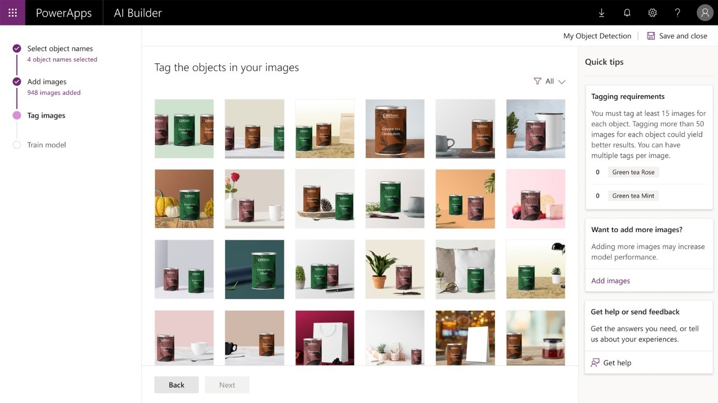
Add intelligence to your apps with AI Builder
AI Builder is a turnkey solution that brings the power of AI through a point-and-click experience
With AI Builder, you can add intelligence to your apps even if you have no coding or data science skills
You can use AI Builder to create custom AI models that suit the needs of your business, or you can choose from a selection of prebuilt models

Slide 10
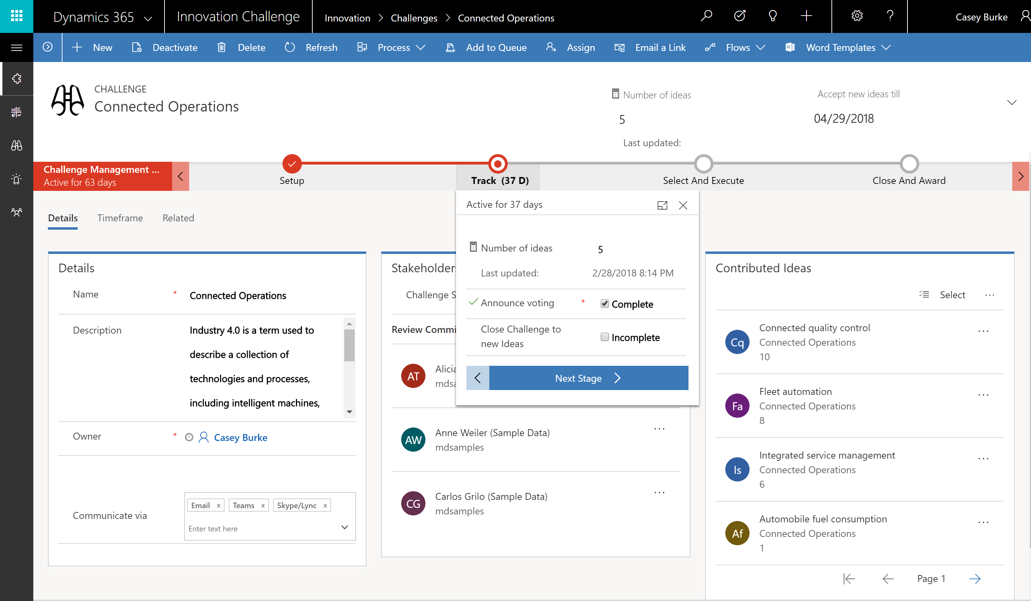
Put all your data to work with Microsoft Dataverse
Jumpstart apps using a standardized data model with business logic, security and integration built-in
Extend to your own needs and integrate across your apps and services
Seamless Dynamics 365, Office 365, and Azure integration, augmented with data from industry partners
Notes:
Microsoft Dataverse is a scalable data service and app platform which lets users securely store and manage data from multiple sources and integrate that data in business applications using a common data model to ensure ease and consistency to users. Dataverse is the common currency that enables the components of Power Platform to work together. It’s the foundation that enables the consolidation, display, and manipulation of data.

Slide 11
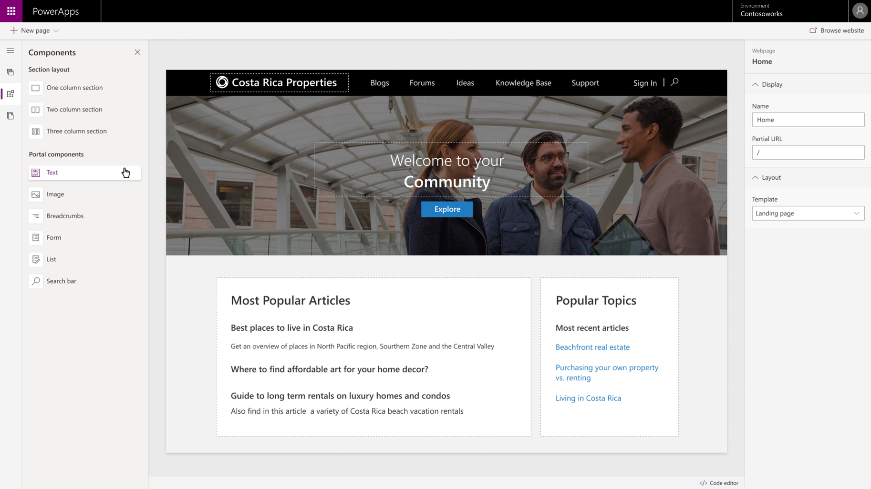
Enable external access with Power Apps portals
Empower anyone—either inside or outside your organization—to interact with Dataverse data using portals
Enable anyone to build responsive websites
Integrate all your data
Notes:
Engage with external customers and partners
Give internal and external users secure access to your data either anonymously or through commercial authentication providers like LinkedIn, Microsoft, Facebook, and Google, or enterprise providers such as Azure AD B2C and Okta. Set authentication requirements, customize data for each user, and allow users to submit their information privately with straightforward admin controls.
Enable anyone to build responsive websites
Easily match websites to the look and feel of your branding with customizable portal templates and responsive themes. Create and manage the content external users and partners can access using an intuitive interface and step-by-step guidance—no code required.
Integrate all your data
Bring data from the apps you use—including Power BI and Power Automate—together with Dataverse and enable your users to interact with it anytime, anywhere . Enrich portals with model-driven forms, views, lists, charts, and dashboards to offer more value with each interaction.

Slide 12
Lesson 2: Data connectors

Slide 13

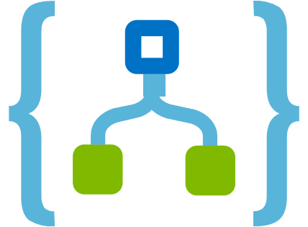
Data connectors
Connectors are available for use in multiple products:
Power Automate
Power Apps
Logic Apps
There are more than 275 connectors between standard and premium ones.
Custom connectors:
An advantage of building custom connectors is that they can be used in different platforms, such as Power Apps, Power Automate, and Azure Logic Apps
It allow you to extend your app by calling a publicly available API, or a custom API you're hosting in a cloud provider, such as Azure
You can create custom connectors using 3 different approaches:
Using a blank custom connector
From an OpenAPI definition
From a Postman collection
Notes:
Connectors enable you to connect apps, data, and devices in the cloud. Consider connectors the bridge across which information and commands travel. There are more than 275 connectors for the Power Platform, enabling all of your data and actions to connect cohesively. Examples of popular connectors include Salesforce, Office 365, Twitter, Dropbox, Google services, and more.
Custom Connectors
While the Power Platform offers more than 200 connectors, you also have the option to build a custom connector. This will allow you to extend your app by calling a publicly available API, or a custom API you're hosting in a cloud provider, such as Azure. API stands for Application Programming Interface and holds a series of functions available for developers. Connectors work by sending information back and forth across these APIs and gathering available functions into Power Apps or Power Automate. Because these connectors are function-based, they will call specific functions in the underlying service of the API to return the corresponding data.

Slide 14
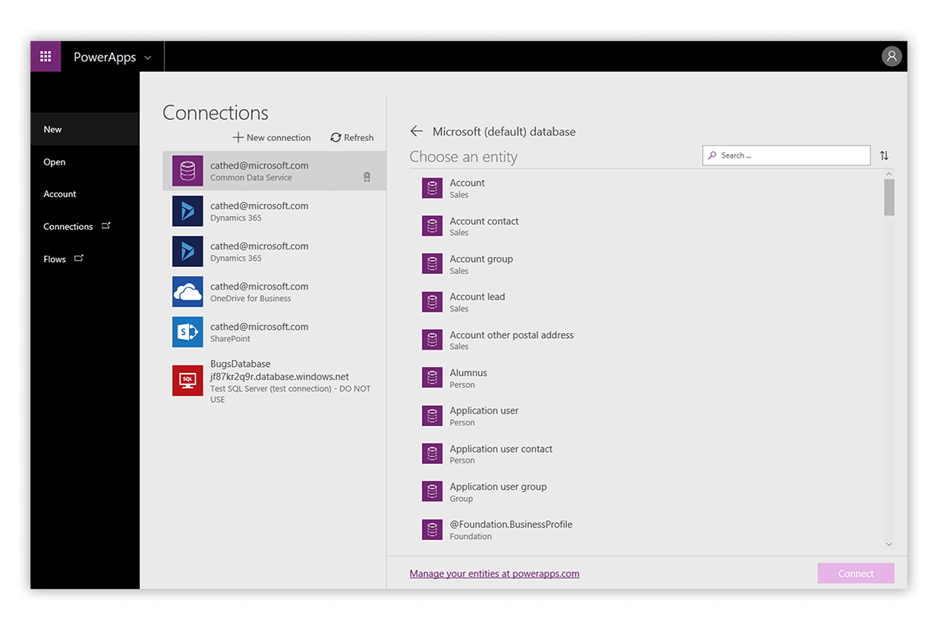
Data sources for connectors
The two types of data sources are tabular and function-based:
Tabular data: A tabular data source is one that returns data in a structured table format. Power Apps can directly read and display these tables through galleries, forms, and other controls. Additionally, if the data source supports it, Power Apps can create, edit, and delete data from these data sources. Examples include Microsoft Dataverse, SharePoint, and SQL Server
Function-based data: A function-based data source is one that uses functions to interact with the data source. These functions can be used to return a table of data, but offer more extensive action such as the ability to send an email, update permissions, or create a calendar event. Examples include Office 365 Users, Project Online, and Azure Blob Storage
Notes:
Both of these data source types are commonly used to bring data and additional functionality to your solutions.
As you can see, connecting to data sources allows you to integrate disparate parts of your business solutions to build them out cohesively.

Slide 15
Components of a connector
Once you have established a data source and configured your connector, there are two types of operations you can use, triggers or actions:
Triggers are only used in Power Automate and prompt a flow to begin. Triggers can be time based, such as a flow which begins every day at 8:00 am, or they could be based off of an action like creating a new row in a table or receiving an email. You will always need a trigger to tell your workflow when to run
Actions are used in Power Automate and Power Apps. Actions are prompted by the user or a trigger and allow interaction with your data source by some function. For example, an action would be sending an email in your workflow or app or writing a new line to a data source
Notes:
Both of these data source types are commonly used to bring data and additional functionality to your solutions.
As you can see, connecting to data sources allows you to integrate disparate parts of your business solutions to build them out cohesively.

Slide 16
Lesson 3: Pulling it all together

Slide 17


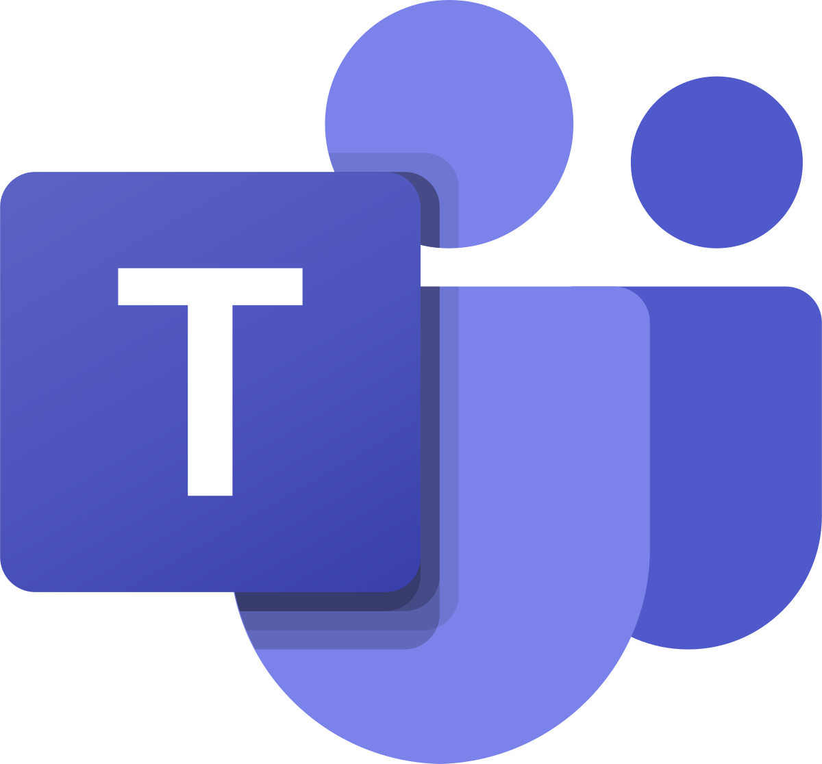
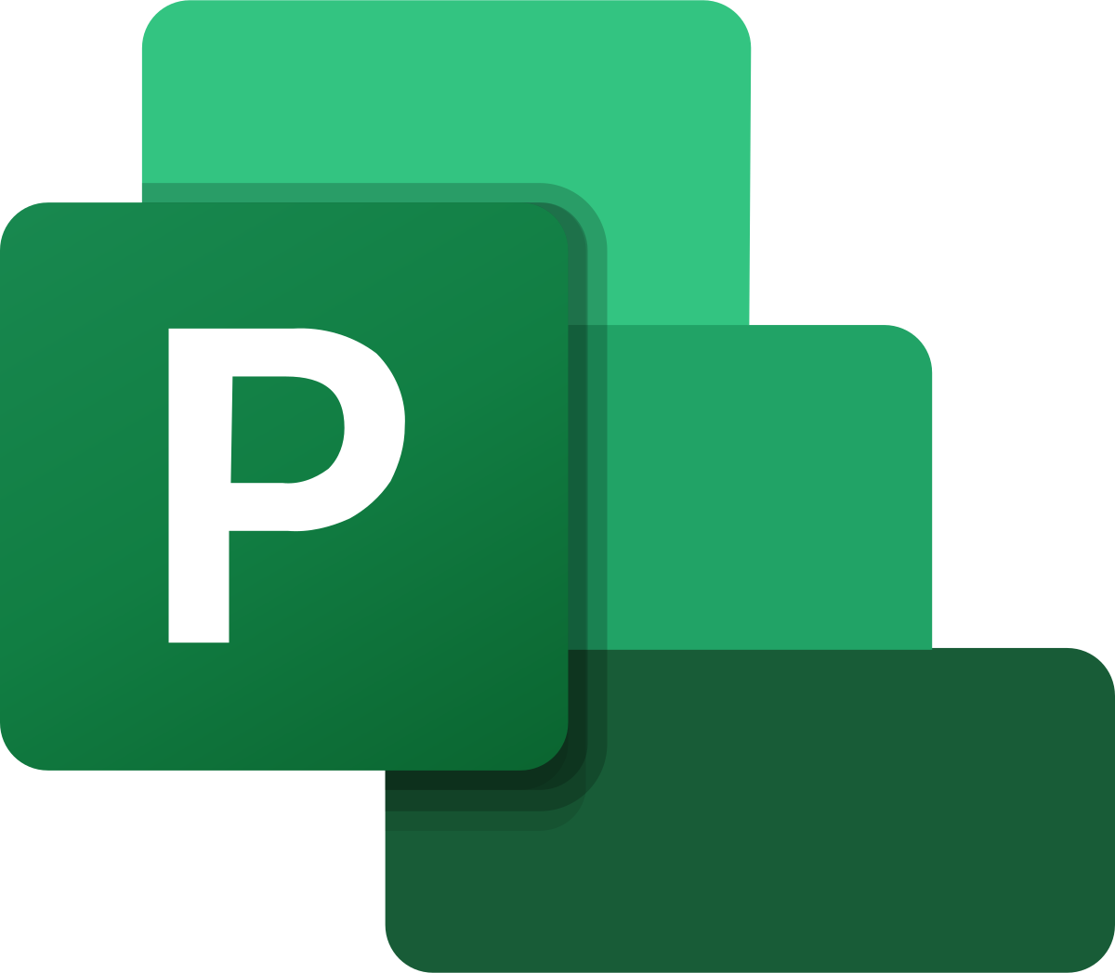











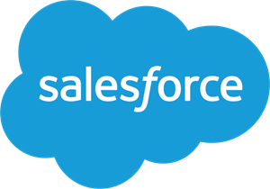

The unmatched functional flexibility of the Microsoft Power Platform
Rich Mobile
Power Apps
Embedded
Power Apps
Secured
Web Portals ¹
Mixed Reality
Experiences
Power Virtual
Agents ¹
Analytics
with PowerBI
Microsoft
Teams
Microsoft
Project²
Microsoft
Dynamics 365²
Microsoft
Office 365
USER EXPERIENCES
PROCESS AUTOMATION
Microsoft Approvals¹
AI
Builder ¹
Power Automate
Flows (DPA)
Power Automate
Process Flows (BPM) ¹
Power Automate
UI Flows (RPA)¹
DATA AND SERVICES
Native Integration to Microsoft 365
Native Integration
to Dynamics 365²
Native Integration
to Microsoft Azure²
On-Premises
Data Gateway ¹
Microsoft
Dataverse
350+
Connectors
Including²
¹ Feature requiring premium Power Platform license or add-on capacity purchase
² Feature might require additional product license
Notes:
Native Integration to Office 365 services and data sources Include:
SharePoint Lists
OneDrive
Excel Online
Office 365 Security and Compliance
Users / Identity and Org Chart
More…
Native Integration to D365 services and data include:
Common Data model
Dataverse
Model Driven Apps and mobile player
Portals
Customer Insights (AI Builder)
Customer Voice
Most D365 services are built on Dataverse
More…
Native Integration to Azure Include:
Azure Active Directory for Makers and End Users
Azure Information Protection
Azure DevOps for Application Life Cycle Management
Azure Application Insights for Usage Monitoring
Exports to Azure Data Lake Storage Gen 2
Azure Logic Apps (sharing connectors with Platform)
More…

Slide 18
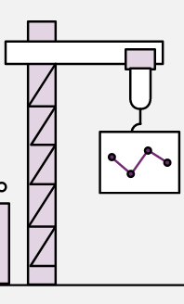
Powerful alone. Better together
Build faster with Microsoft Dataverse: Make it easier to bring your data together and quickly create powerful apps using Microsoft Dataverse, a compliant and scalable data service and app platform that’s integrated into Power Apps
Get a single source of truth across your organization: As Microsoft Dataverse standardizes your data through the common data model, it’s easier to build and run apps using the same data. And because Dynamics 365 applications are natively built on it, you can also build apps without needing additional data integration. All with the enterprise-grade security and manageability of Power Apps
Automate your apps with a business process engine: Guide people through business processes, start workflows automatically, and provide rules for your data validation using business process flows. Make your apps smarter with visually defined server-side logic that can set default values or provide validation logic
Built on the foundation of the common data model: By defining a set of over 200 standard business tables, the common data model makes it easier for both you and third-parties to build apps. Tailor the model to your specific business needs by extending with custom tables and columns

Slide 19
Summary
Microsoft Power Platform offers a point-and-click approach which makes it easy for anyone familiar with Microsoft Office to create custom business solutions, data visualizations, and automated workflows
It enables users to do three key actions on data that help them drive business:
Gain insights from data (Analyze)
Drive intelligent business processes via apps they build (Act)
Automate business processes (Automate)
Power BI helps you analyze and visualize data on a unified platform with data from internal and external sources
Power Apps helps you build and deploy customized apps that work across web and mobile, embedded or standalone, on any device
Power Automate helps you create automation workflows, from simple to advanced scenarios
Power Virtual Agents helps you create Chatbots

Slide 20
Get started with Power Apps
Notes:
Link: https://docs.microsoft.com/en-us/learn/modules/powerapps-get-started/

Slide 21
Lesson 4: Get started with Power Apps

Slide 22
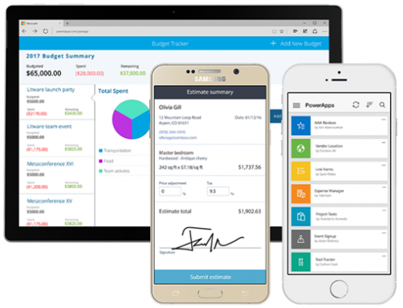
Intro to Power Apps
With Power Apps, you can:
Build an app quickly by using the skills that you already have
Connect to the cloud services and data sources that you're already using
Share your apps instantly so that coworkers can use them on their phones and tablets
Notes:
This unit explores each part of the following Power Apps components:
Power Apps Home Page - Apps start here, whether you build them from data, a sample app, or a blank screen.
Power Apps Studio - Develop your apps further by connecting to data, adding and arranging user interface (UI) elements (known as controls), and building formulas.
Power Apps Mobile - Run your apps on Microsoft Windows, Apple iOS, and Google Android devices.
Power Apps Admin Center - Manage Power Apps environments and other components.

Slide 23
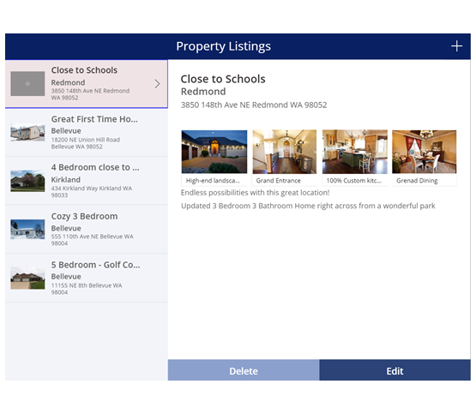
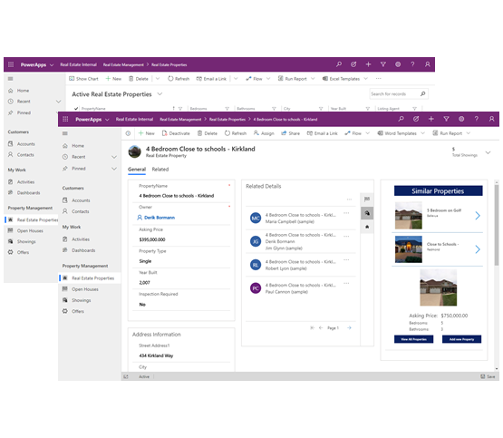
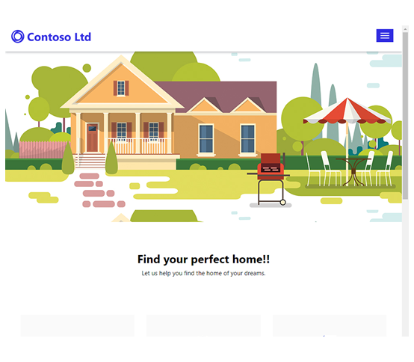
What types of app can you build?
Canvas
Model-Driven
Portal apps
User experience focused, typically task or role-based apps leveraging mash up data from multiple data sources
Leverages your organizations data model, relationships, and business processes in immersive, responsive applications
Provides secure data access to internal and external stakeholders
Notes:
Today there are 3 main types of Power Apps; canvas apps, model-driven apps and portal apps. Historically, model-driven apps are an evolution of applications built on Dynamics CRM (aka xRM). Power Apps Portals evolved from Dynamics 365 Portals. Power Apps Portals can now be run on vanilla Dataverse instances.

Slide 24
What’s the difference?
Canvas
Model-driven
Leverage data from different sources
Back ended by Dataverse
Generally task or screen fo cused
Focused on processes
Customized UI
Responsive UI
Device Interaction
Customizing existing apps
Embedding capabilities
Data relationship navigation
Security trimming of UI
Notes:
CDS is great for canvas, but if all you need is other data connectors offer a quicker start
Customizing existing apps – you can customize a prebuilt model-driven app, and updates still work from the provider, where as a canvas is all or nothing
User personalization – Dashboards, Views, Templates
Standard UX (low training cost), extensibility
Canvas - Multiple connectors, i.e. bridging the systems via UI

Slide 25
Power Apps building blocks
Power Apps Home Page – Apps start here, whether you build them from data, a sample app, or a blank screen
Power Apps Studio – Develop your apps further by connecting to data, adding and arranging user interface (UI) elements (known as controls), and building formulas
Power Apps Mobile – Run your apps on Microsoft Windows, Apple iOS, and Google Android devices
Power Apps Admin Center – Manage Power Apps environments and other components
Notes:
This unit explores each part of the following Power Apps components:
Power Apps Home Page - Apps start here, whether you build them from data, a sample app, or a blank screen.
Power Apps Studio - Develop your apps further by connecting to data, adding and arranging user interface (UI) elements (known as controls), and building formulas.
Power Apps Mobile - Run your apps on Microsoft Windows, Apple iOS, and Google Android devices.
Power Apps Admin Center - Manage Power Apps environments and other components.

Slide 26
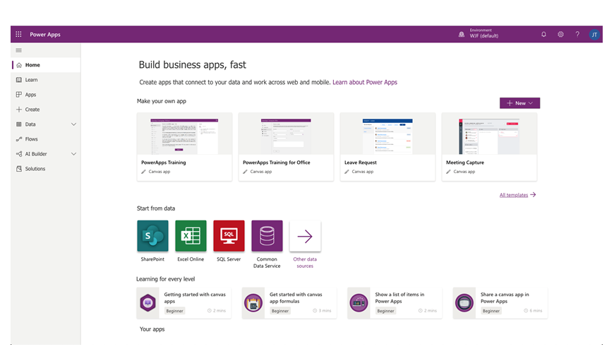

Power Apps home page
Lets you easily build apps from sample apps, templates, or a blank screen
All the apps that you've built appear here, along with any apps that others have created and shared with you
Notes:
If you are building an app, you'll start with the Power Apps Home Page. You can build apps from sample apps, templates, or a blank screen. All the apps that you've built appear here, along with any apps that others have created and shared with you.

Slide 27
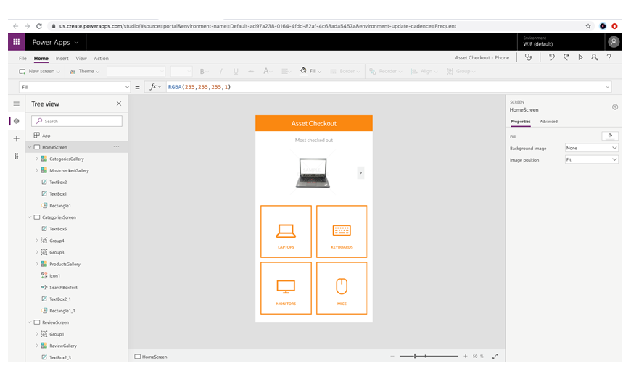
Power Apps Studio
Power Apps Studio is where you can fully develop your apps to make them more effective as a business tool and to make them more attractive:
Left pane – Shows hierarchical view the controls on each screen or a thumbnail for each screen in your app
Middle pane – Shows the canvas app that you're working on
Right pane – Where you set options such as the layout, properties, and data sources for certain controls
Notes:
Power Apps Studio is where you can fully develop your apps to make them more effective as a business tool and to make them more attractive. Power Apps Studio has three panes that make creating apps seem more like building a slide deck in Microsoft PowerPoint:
Left pane - Shows a hierarchical view of all the controls on each screen or a thumbnail for each screen in your app.
Middle pane - Shows the canvas app that you're working on.
Right pane - Where you set options such as the layout, properties, and data sources for certain controls.

Slide 28
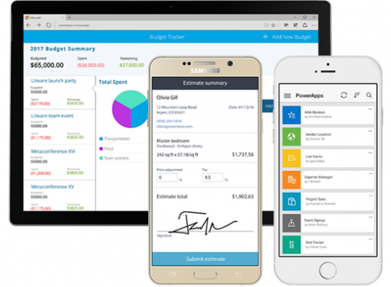
Power Apps Mobile
Power Apps Mobile for Windows, iOS, and Android devices allows you to use all the apps that you've created, and those others have shared with you, on your mobile device
Notes:
Power Apps Mobile for Windows, iOS, and Android devices allows you to use all the apps that you've created, and those others have shared with you, on your mobile device. You or your users can download the Microsoft Power Apps app from the appropriate app store. When users log in with their credentials, they will see all apps that have been shared with them. The Power Apps Mobile app only needs to be downloaded once.
When you use apps in Power Apps Mobile, you get the most out of your device's capabilities: camera controls, GPS location, and more.

Slide 29
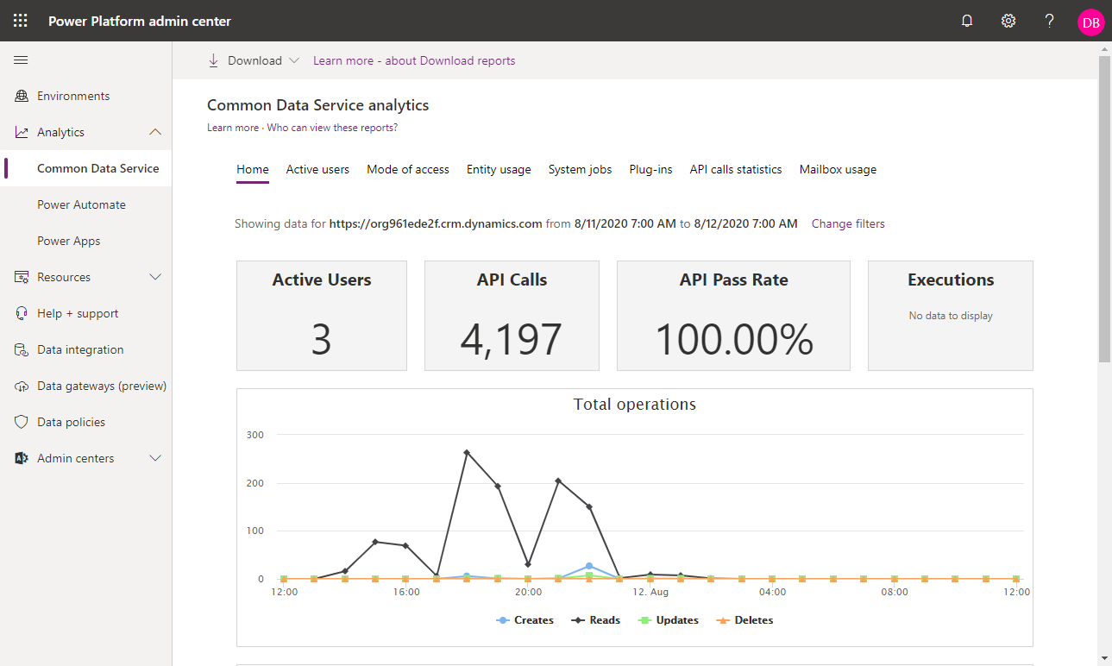
Power Apps admin center
The Power Apps admin center is the centralized place for managing Power Apps for an organization
Notes:
The Power Apps admin center is the centralized place for managing Power Apps for an organization. On this site, you can define and manage different environments to house the apps. For example, you might have separate environments for development and production apps. Additionally, you can define data connections and manage environment roles and data policies.

Slide 30

Power Apps related technologies

Slide 31
Power Apps related technologies
Microsoft Power Apps works with other technologies to help you build powerful apps for your organization:
Data sources – Without data, you don't have a business. Data sources bring cloud and on-premises data into your apps. You access data through built-in connections, custom connectors, and gateways
Dataverse – A compliant and scalable data service that's integrated into Power Apps
Power Automate – Allows you to build automated workflows to receive notifications, run processes, collect data, and more
Notes:
Microsoft Power Apps works with other technologies to help you build powerful apps for your organization. Some of these technologies include:
Data sources - Without data, you don't have a business. Data sources bring cloud and on-premises data into your apps. You access data through built-in connections, custom connectors, and gateways.
Dataverse - A compliant and scalable data service that's integrated into Power Apps.
Power Automate - Allows you to build automated workflows to receive notifications, run processes, collect data, and more.

Slide 32
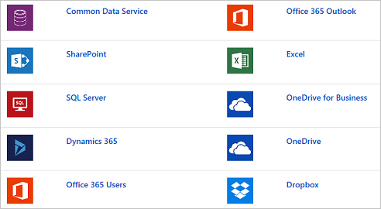
Data sources, connections, and gateways
Most canvas apps and many Power Automate flows use external information that is stored
in data sources
Notes:
In Power Apps, most canvas apps use external information that is stored in Data Sources. A common example is a table in an Excel file that is stored in OneDrive for Business or SharePoint. Apps access these data sources by using connections. Some connections allow Power Apps to read and write stored data. In Power Apps, you can add many data sources to your apps through built-in or custom connectors. Some of the most popular data sources are shown in the following figure.
Many data sources are cloud services, like Salesforce. Even Twitter can be a data source if, for example, you're tracking your company's hashtags. Connectors might not seem like the most exciting part of app development; however, they're essential when you work with data that you, your colleagues, and your customers care about. When an app shows up with your data source for the first time, you might suddenly find that they are, in fact, exciting.
For data that's stored on-premises instead of in the cloud, you can use a gateway to provide a reliable connection between Power Apps and your data source. The gateway sits on an on-premises computer and communicates with Power Apps.
An advantage of building your business apps in Power Apps is being able to connect to many data sources in a single app. With the connectors in Power Apps, you can connect to where your data lives. To learn more about data sources in Power Apps, refer to the Working With Data learning path.

Slide 33
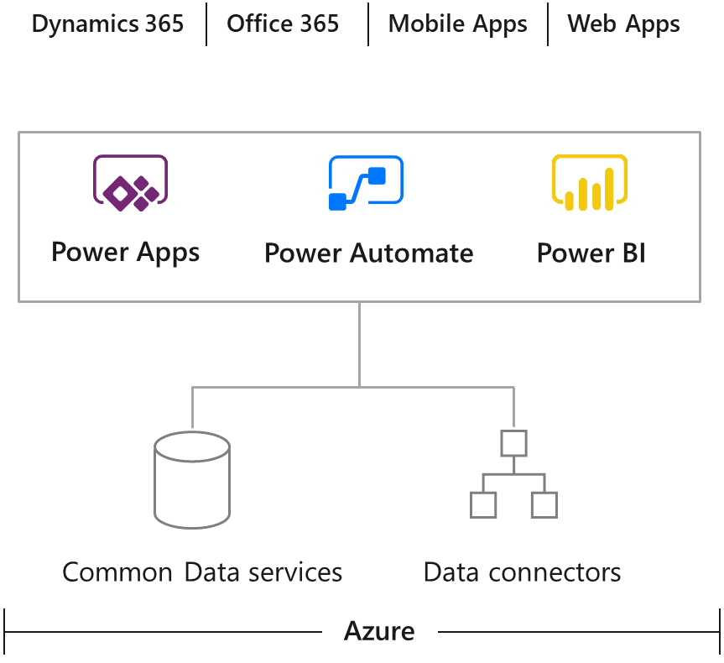
Dataverse
Lets you store and manage data used by business applications
Data is stored within a set of tables
Includes a base set of standard tables that cover typical scenarios
Customer tables can be created specific to your organization
App makers can then use Power Apps to build rich applications by using this data
Notes:
An important data source option to explore further is the Dataverse. Dataverse lets you store and manage data that's used by business applications. Data within Dataverse is stored within a set of tables. An table is a set of rows that are used to store data, similar to how a table stores data within a database. Dataverse includes a base set of standard tables that cover typical scenarios, but you can also create custom tables that are specific to your organization and then populate them with data by using Power Query. App makers can then use Power Apps to build rich applications by using this data.
For information on purchasing a plan to use Dataverse, refer to the Licenseand Pricinginformation pages.

Slide 34
Reasons to use the Dataverse
Standard and custom tables provide a cloud-based storage option for your data:
Simple to manage
Helps to secure data
Access your Dynamics 365 Data
Rich metadata
Logic and validation
Productivity tools
Notes:
Standard and custom tables within Dataverse provide a cloud-based storage option for your data. Tables let you create a business-focused definition of your organization's data for use within apps. If you're unsure if tables are your best option, consider the following benefits:
Simple to manage - Both the metadata and data are stored in the cloud. You don't need to worry about the details of how they're stored.
Helps to secure data - Data is stored so that users can see it only if you grant them access. Role-based security allows you to control access to tables for different users within your organization.
Access your Dynamics 365 Data - Data from your Dynamics 365 applications is also stored within the Dataverse, which allows you to quickly build apps that use your Dynamics 365 data and extend your apps by using Power Apps.
Rich metadata - Data types and relationships are used directly within Power Apps.
Logic and validation - Define calculated columns, business rules, workflows, and business process flows to ensure data quality and drive business processes.
Productivity tools - Tables are available within the add-ins for Microsoft Excel to increase productivity and ensure data accessibility.

